Slide 1
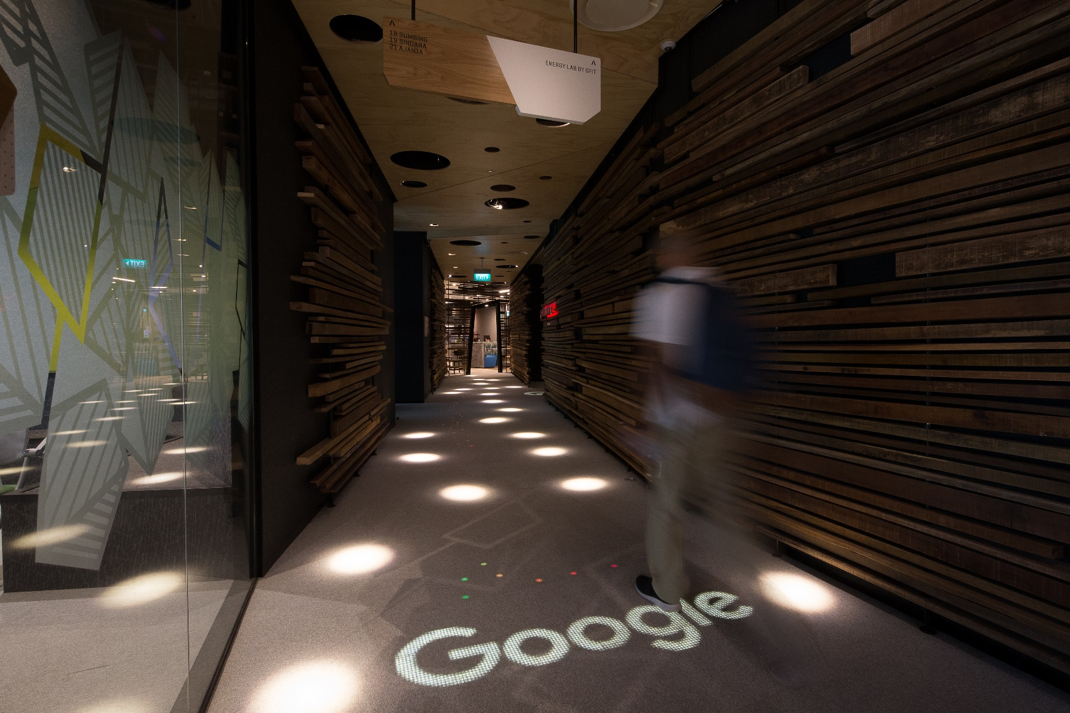
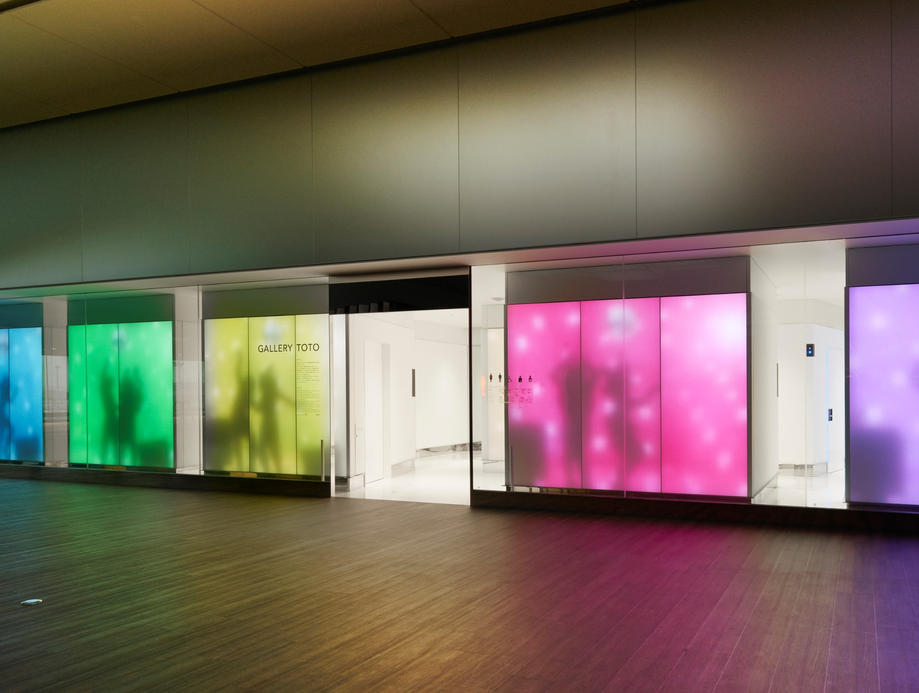
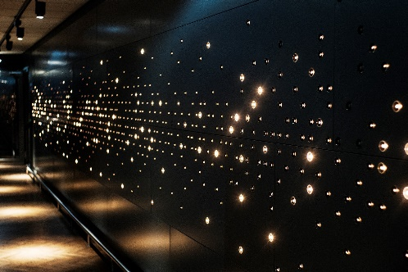
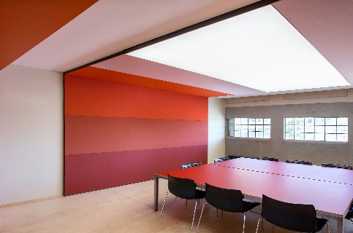
Philips Luminous Solutions
The fusion of light and Materials
Luminous
Flooring
Luminous
Textile
Luminous
Patterns
OneSpace
Luminous Ceiling
Berno Ram
Business Development Manager
February 2018
Notes:
Introduce yourself & relation to luminous solutions
First I’ll show you some inspirational pictures.

Slide 2
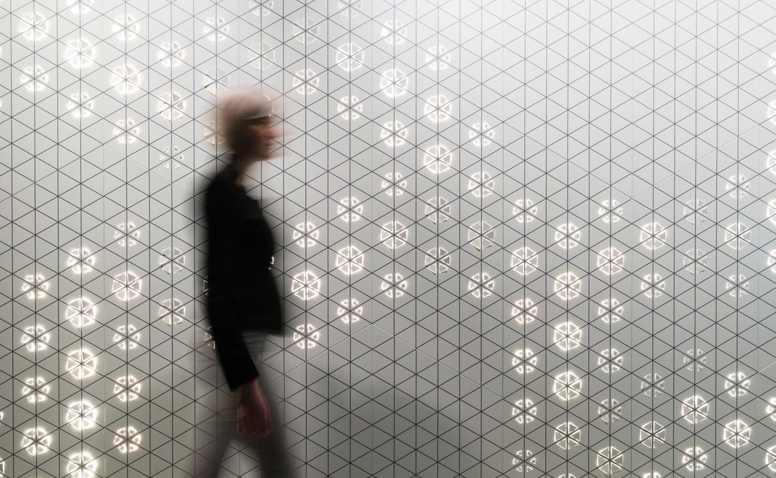
Luminous Solutions
Embedded Lighting
Fusion of light and material
Some backgrounds
Notes:
With LED lighting, we can now fuse lighting into architectural surfaces. The “embedded lighting” technology is changing the way architects conceive of architectural lighting solutions.

Slide 3

Architectural
System
Lighting Technology
Notes:
Lighting has traditionally been hot, dangerous, fragile, and objectified. The light fixture casts light on the “dumb” lump of stone, sticks, glass, steel.

Slide 4
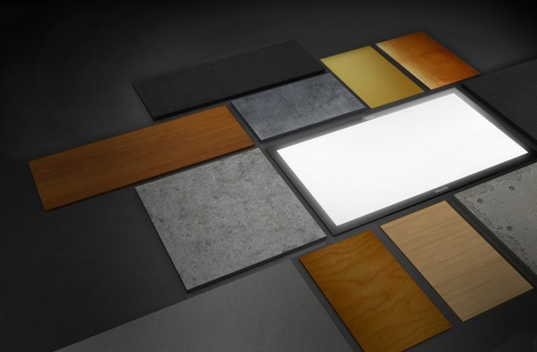
Architects want to treat light like a material
Notes:
Modernist architects valued the simple presentation of forms and materials. We believe they want to treat lighting in a similar way – as a material, not an object.

Slide 5
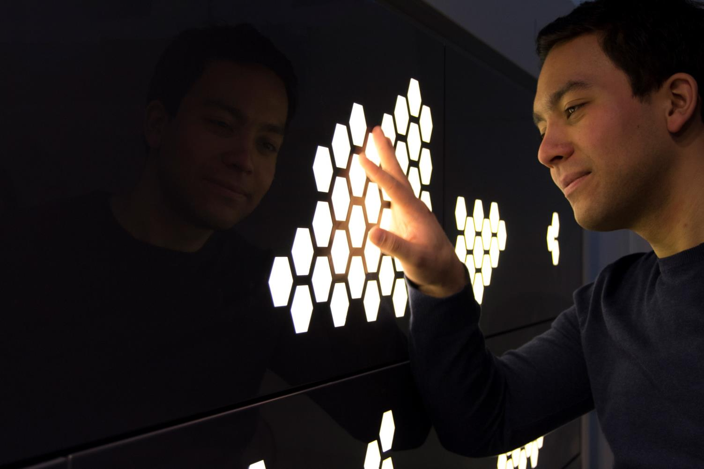
With LEDs we have the opportunity to bring spaces to life by fusing light into architectural surfaces
Notes:
With LED lighting we have the opportunity to fuse light into architectural surfaces. How will designers use this new capability? How will this change architectural design and architectural lighting paradigms?

Slide 6
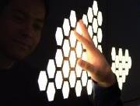
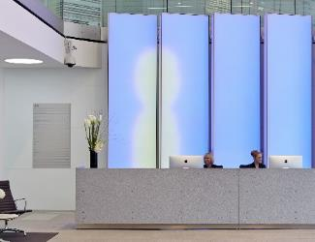

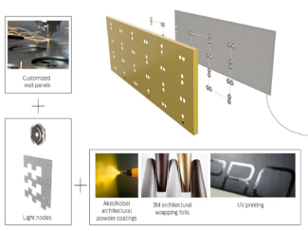
Philips luminous solutions
Fusion of light and
material
LED lighting embedded into architectural surfaces
Treating light as a material
Design
statement
Design solution custom-tailored concepts to create unique distinctive designs
Flexible lighting solutions for signature interior spaces
Connected
systems
Dynamic animation and content adds presence to architectural surfaces
A wide variety of integration and control options
All-in-one
solution
From design to implementation
Global support via Philips and our network of Value Added Partners
Notes:
Use when ‘the bigger picture is needed’
What do these propositions have in common?
What are our shared values?

Slide 7
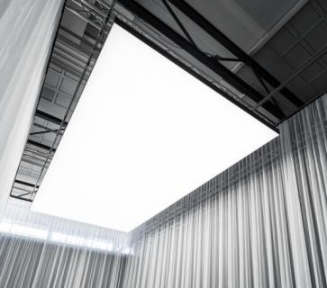
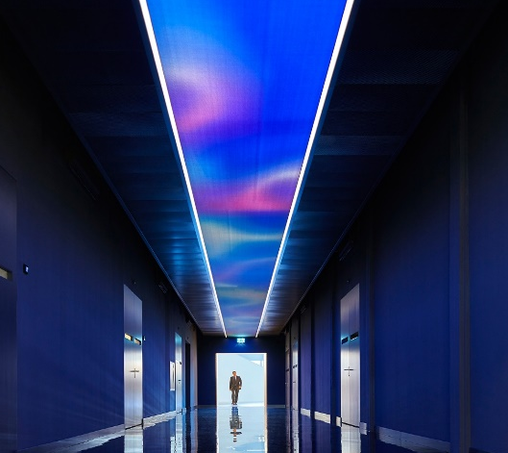
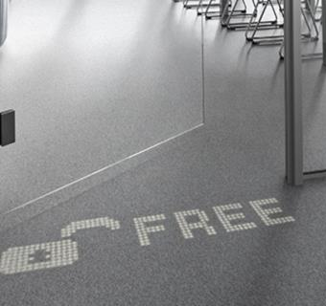
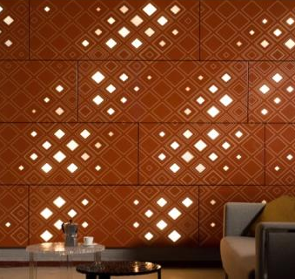
Philips Luminous Solutions,
Luminous ceilings
Luminous textiles
Luminous flooring
Luminous patterns
Notes:
Examples of ready to install embedded lighting systems are starting to appear on the market…

Slide 8
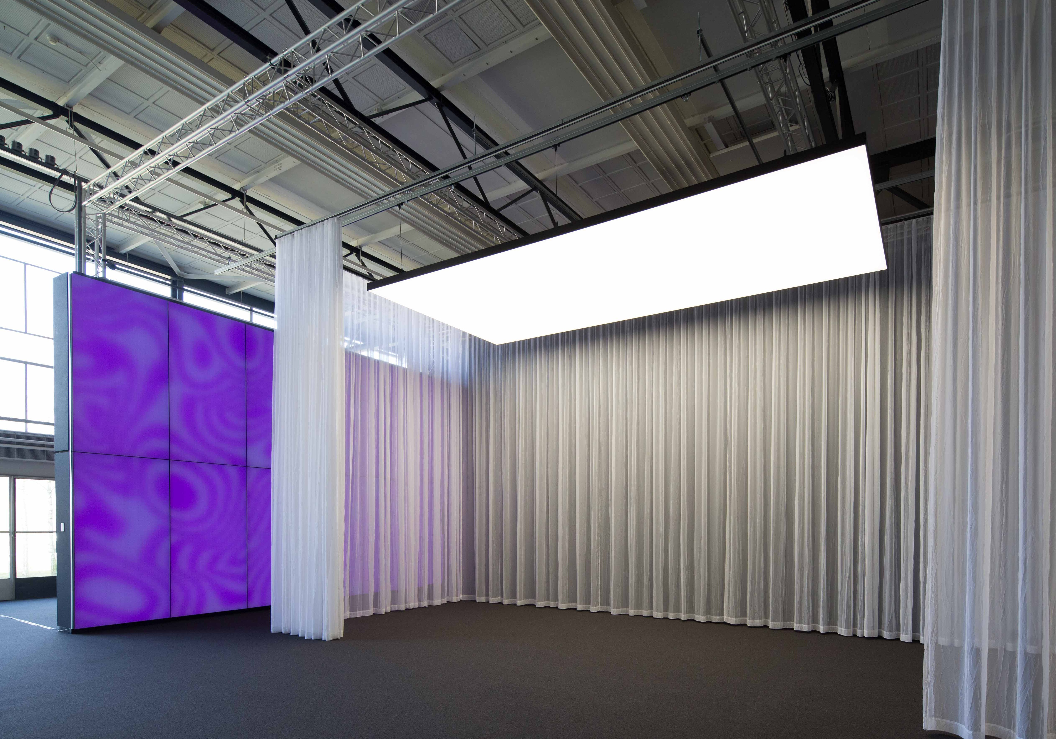
We bring large surfaces like walls and ceilings to life with ambient and functional lighting solutions.
Our flexible design elements enable (interior) architects to integrate these light emitting walls and ceilings in their unique designs.
Large Luminous Surfaces
Notes:
End-to-end organization with global scope
Focus on large surfaces (walls, ceilings)
Part of Philips Professional Lighting Solutions, Global Systems
History: LED in textile
2010 Partnership Kvadrat: Philips luminous textile with Kvadrat Soft Cells
Target audience: creative specifiers
2014 Functional white light: Philips OneSpace luminous ceiling
Able to fast translate market demands from business to business customers (e.a. creative specifiers) into lighting solutions.
Philips luminous textile with Kvadrat Soft Cells: from VOC to 12 NC in 9 months
Philips OneSpace luminous ceiling: from VOC to 12 NC in 12 months
Focus ‘customers’ are creative specifiers
Interior designers, building architects and lighting designers
2 product propositions
Ambient lighting: Philips luminous textile with Kvadrat Soft Cells
Functional lighting: Philips OneSpace luminous ceiling
Part of Philips Professional Lighting Solutions, Global Systems
www.largeluminoussurfaces.com

Slide 9
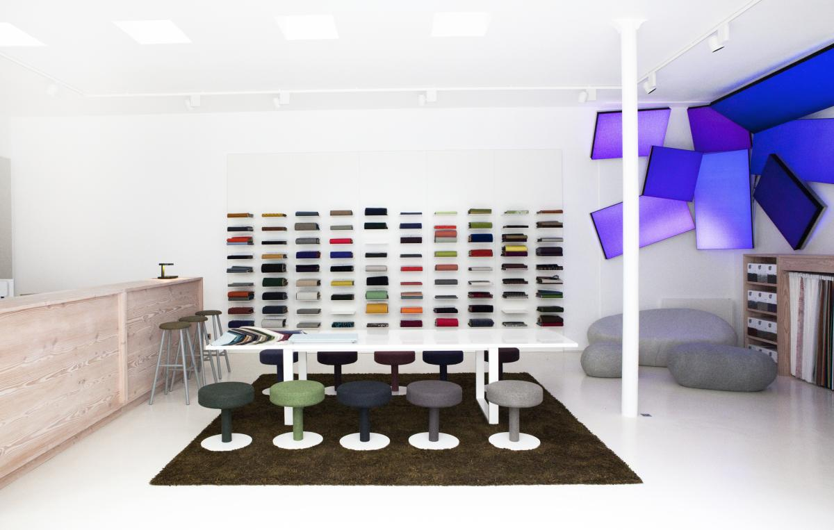
Kvadrat – Partner in innovation

Slide 10
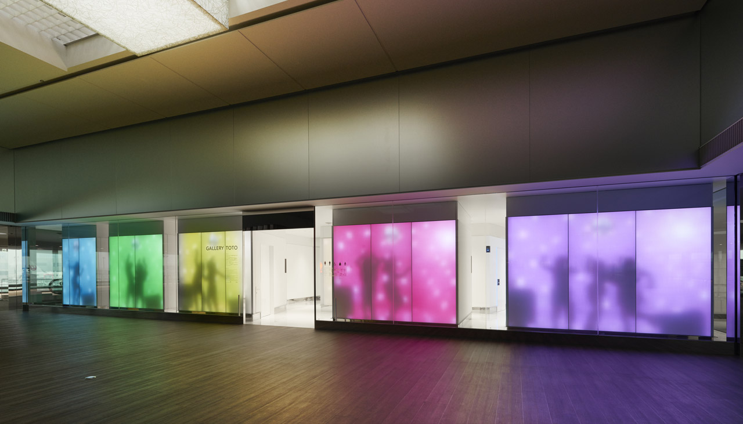
Philips luminous textile with Kvadrat Soft Cells
Notes:
Video by Daisuke Ohki showing Philips luminous textile with Kvadrat Soft Cells at Gallery Toto, Narita International Airport Japan.
Architects: Astrid Klein & Mark Dytham, architecture (KDa): “The hundreds of people sitting there waiting for their flights are probably pretty bored. That’s why we thought that the videos displayed on the external walls of GALLERY TOTO, in particular, should be something that anyone can enjoy. Actually, people enjoy watching what others are doing – people watching, right? So, the video that runs on the external wall – ‘Toilet Life’ – that’s the hint. There are people doing weird dances and stuff around the toilet bowl. We made a story that sparks the imagination by wondering what other people do in the toilet. The fact that you can see a place that is usually hidden is another element which engages your curiosity.”
Art direction: Yasuyuki Tamenaga (black*bath)
More info: http://www.largeluminoussurfaces.com
http://www.toto.co.jp/gallerytoto/en/

Slide 11
Positioning statement
Luminous textile integrates multi-colored LEDs seamlessly within beautiful fabric panels that also soften sound.
A concept that gives you endless ways to play with color, movement, texture and light. So you can express emotions, make a design statement and bring spaces alive.

Slide 12
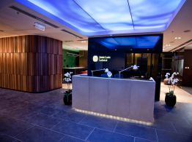
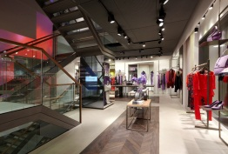
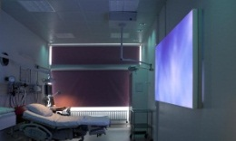
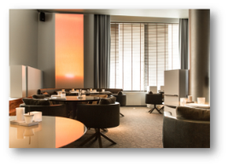
Luminous textile
Different spaces, specific added values, meaningful solutions
Office | Retail
Healthcare | Hospitality
JLL, Vivaldi Plaza, Moscow, Russia
Laurel, Munich, Germany
6
Nordsjællands Hospital, Sensory Birthing Room, Hillerød, Denmark
Beluga Restaurant,
Maastricht, Netherlands
Notes:
Slide intent:
The meaningfulness / added value of luminous textile varies across segments and spaces. For example, luminous textiles can be used to communicate a brand identity, to draw attention and to guide people. Content plays an important role in underpinning these added value directions!
Identify spaces and introduce added value of LTPs in the relevant spaces.

Slide 13
Luminous textile
Different spaces, specific added values, meaningful solutions
Office | Retail
Healthcare | Hospitality
Energize working place
Stimulate creativity
Kill time in waiting areas (reception)
Contribute to brand identity
Contribute to inspiring work environment
Soften sound
Increase time spent in the shop
Change product atmosphere
Entertain
Create magical effects to attract people
Scene setting in stores
Contribute to store personality
Shorter time perception in waiting areas
reduce stress (in sensitive areas)
Support energizing working place
Distract from illness/pain
Well-being
Create positive atmosphere,
patient feels better
Kill time/entertain in waiting areas
Bring outside in (hotel rooms)
Support multiple functions
Support scene setting
Feel at home, support well-being
Contribute to brand identity
6
Notes:
Slide intent:
The meaningfulness / added value of luminous textile varies across segments and spaces. For example, luminous textiles can be used to communicate a brand identity, to draw attention and to guide people. Content plays an important role in underpinning these added value directions!
Identify spaces and introduce added value of LTPs in the relevant spaces.

Slide 14
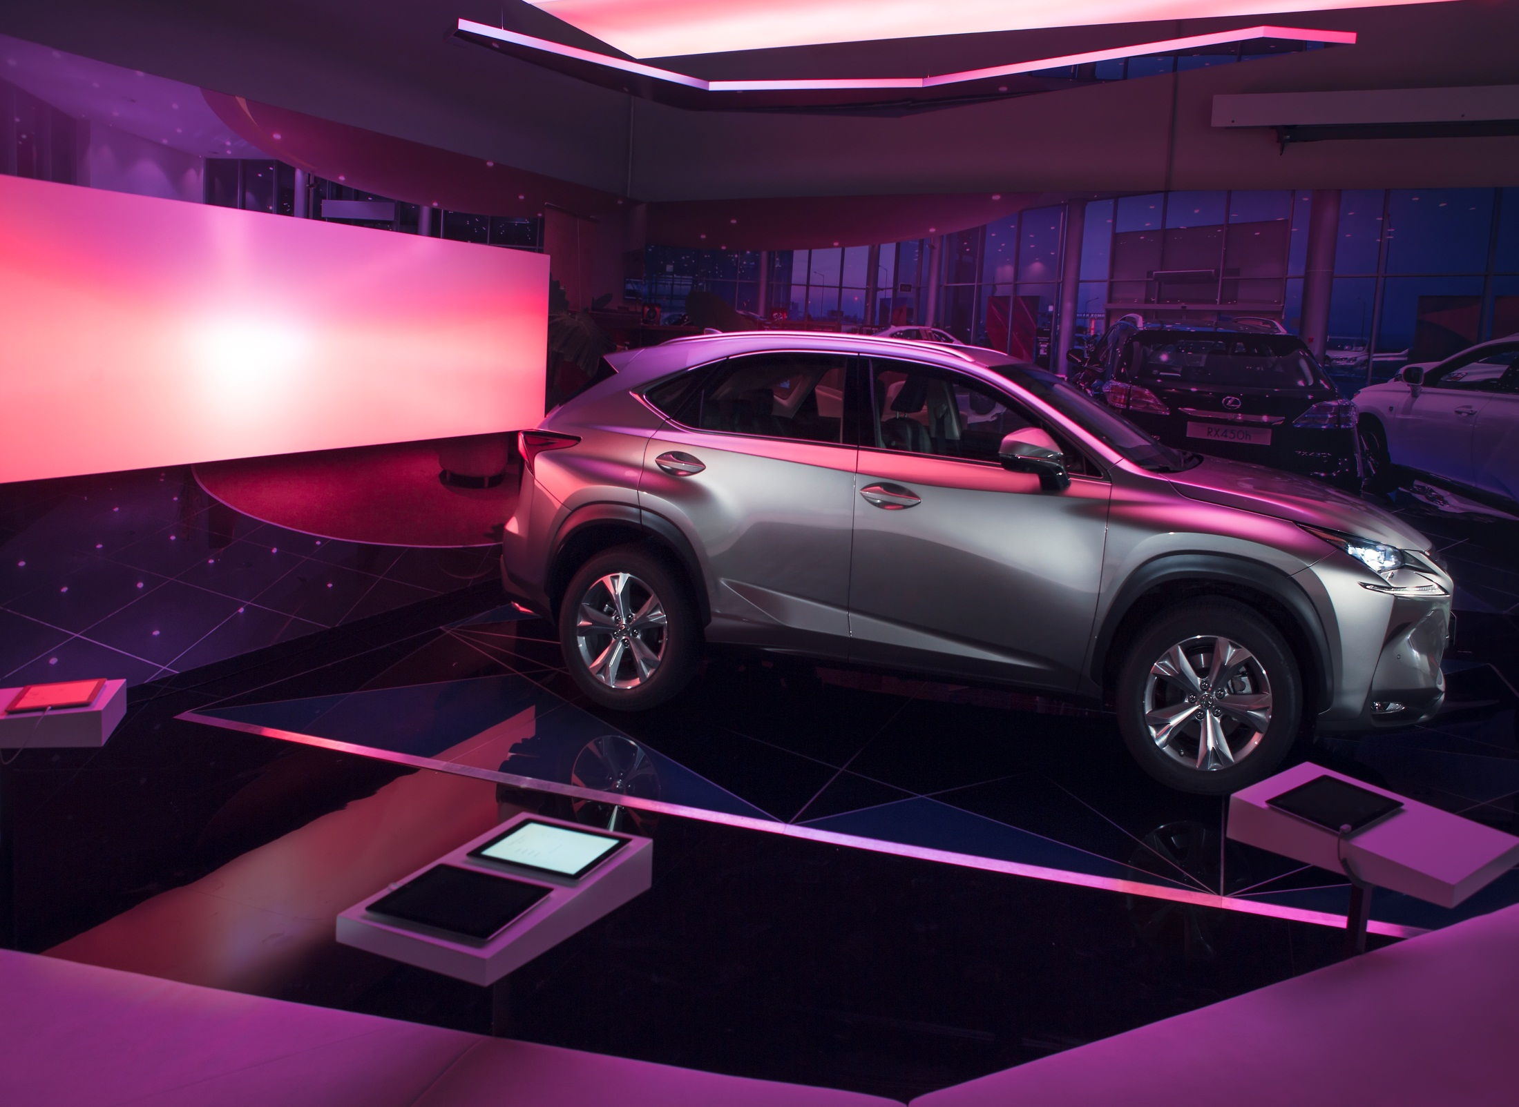
Lexus-Rublevskiy Car Showroom, Moscow, Russia
Notes:
Slide intent
Demonstrate how panels on the shop floor / store architecture can draw attention to a specific product category
Image:
Project: Lexus-Rublevskiy
Product: Combination Kvadrat Soft Cells & Philips luminous textiles
See: http://www.largeluminoussurfaces.com/content/prrulexus-rublevskiy-moscow

Slide 15
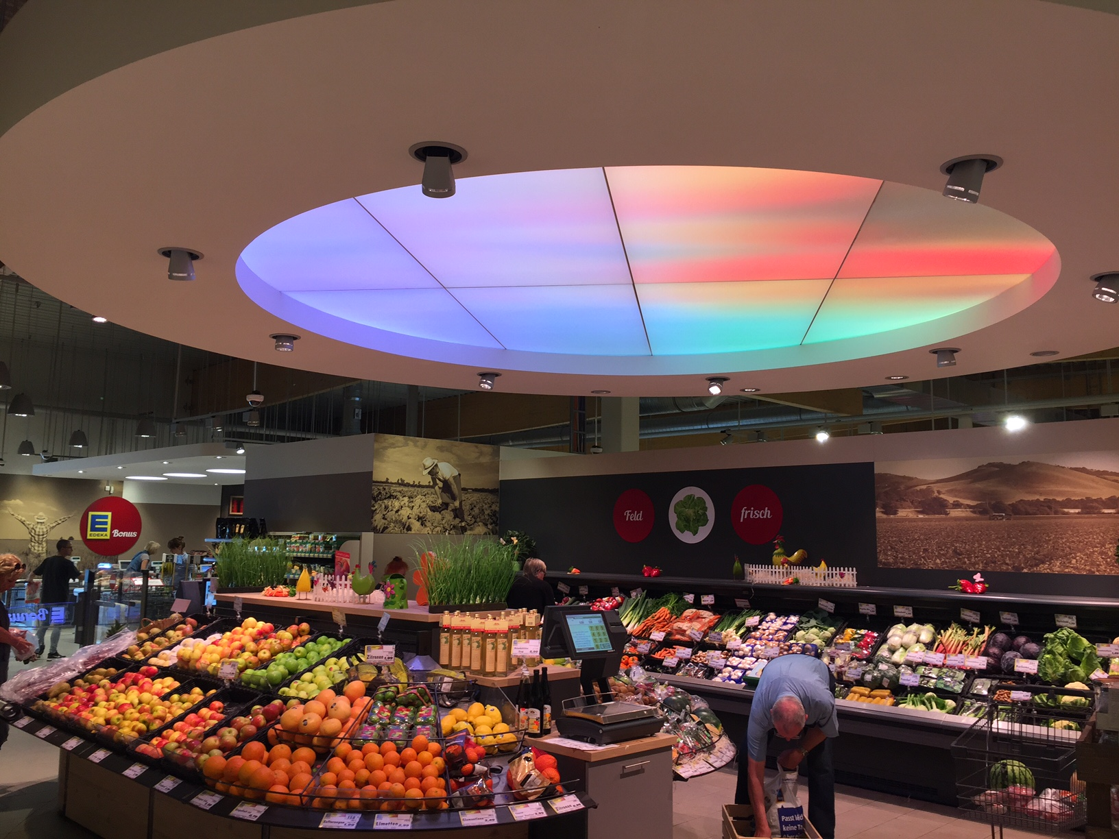
EDEKA Supermarket, Gaimersheim
Edeka Supermarket, Gaimersheim, Germany
Notes:
Slide intent
Demonstrate how panels on the shop floor / store architecture can draw attention to a specific product category
Image:
Project: Wine department at EDEKA Supermarket, Aachen, Germany
Product: Combination Kvadrat Soft Cells & Philips luminous textiles
See: http://www.largeluminoussurfaces.com/content/prdeedeka-wine

Slide 16
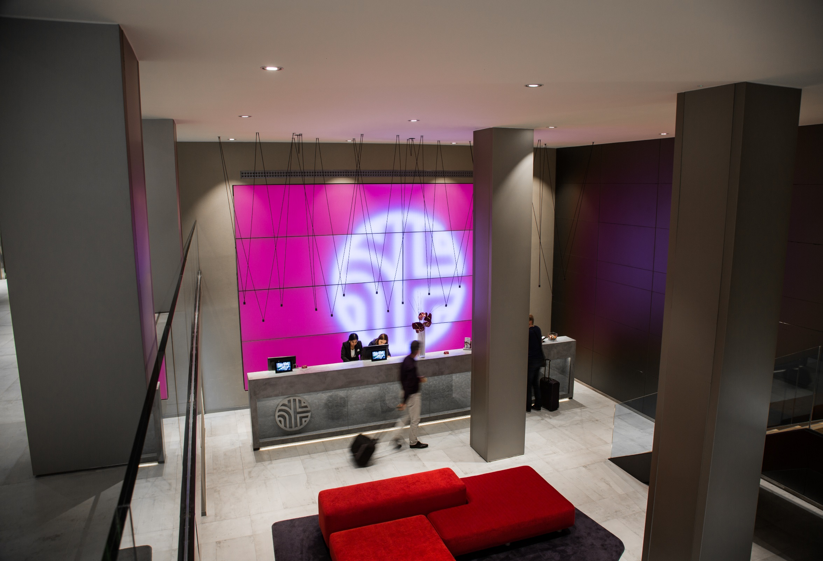
Reception area Hotel Sanvy, Madrid, Spain
Notes:
Image:
200 Gray’s Inn Road, London, UK
Combination Kvadrat Soft Cells & luminous textiles

Slide 17
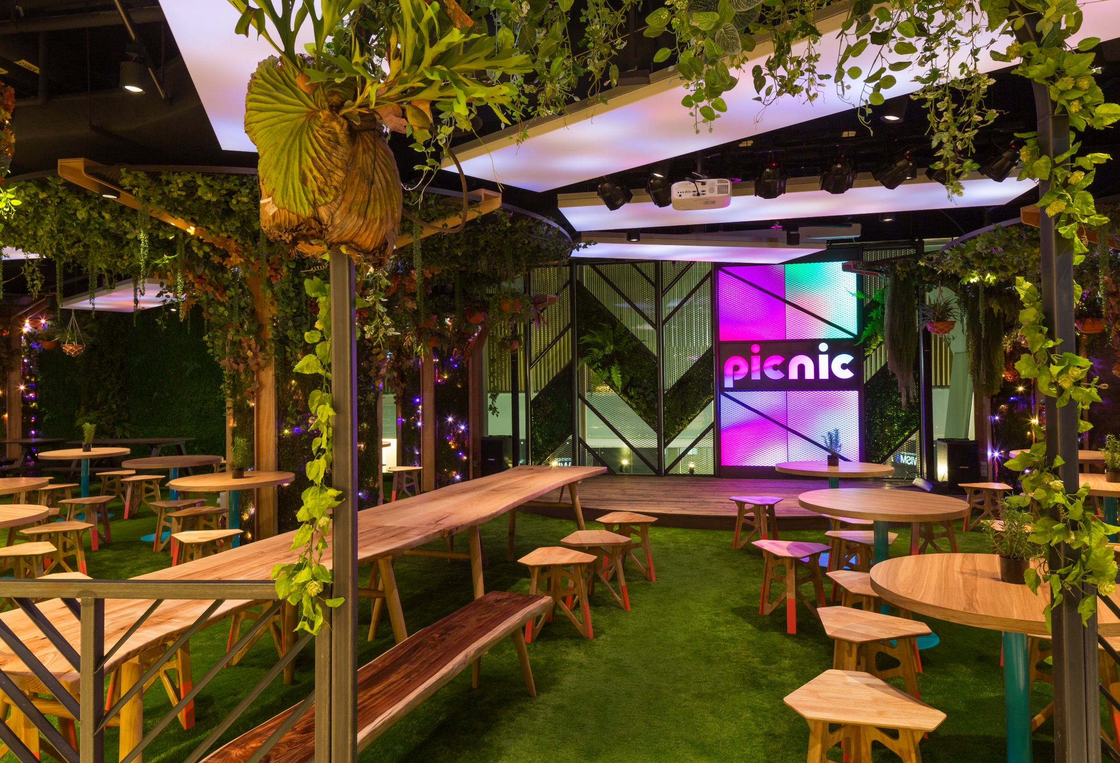
Picnic Restaurant, Singapore
Notes:
Image:
Philips Stadion, Eindhoven, the Netherlands
Combination Kvadrat Soft Cells & luminous textiles

Slide 18
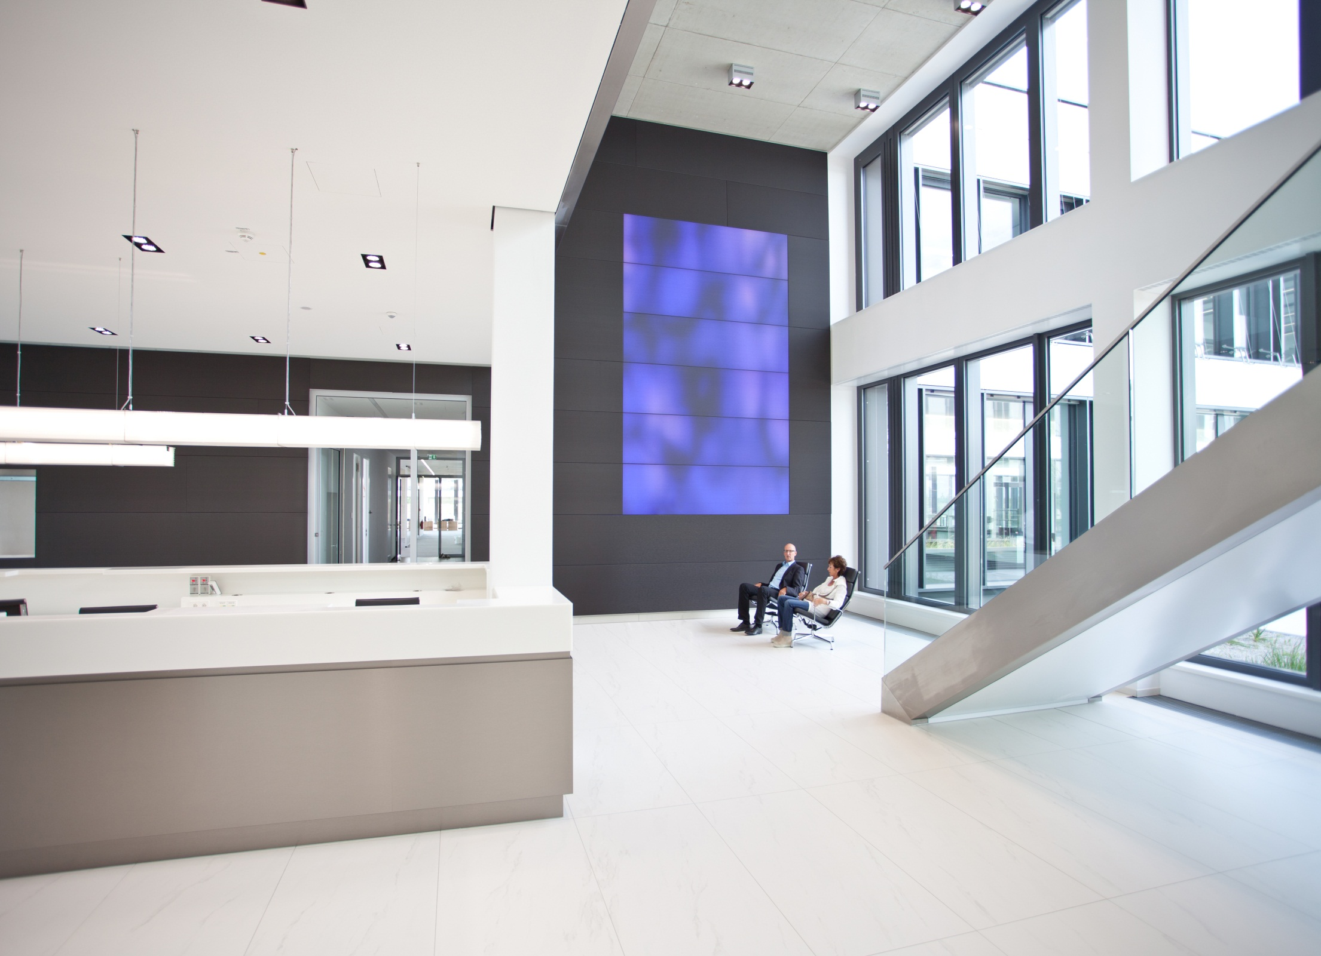
Arthrex, Munich, Germany
Notes:
About photo:
Reception Arthrex, Munich, Germany.

Slide 19
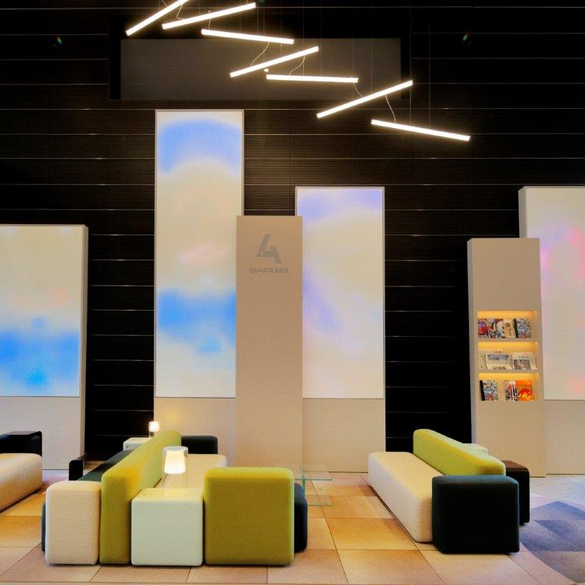
Quadrans relax area, Paris, France

Slide 20
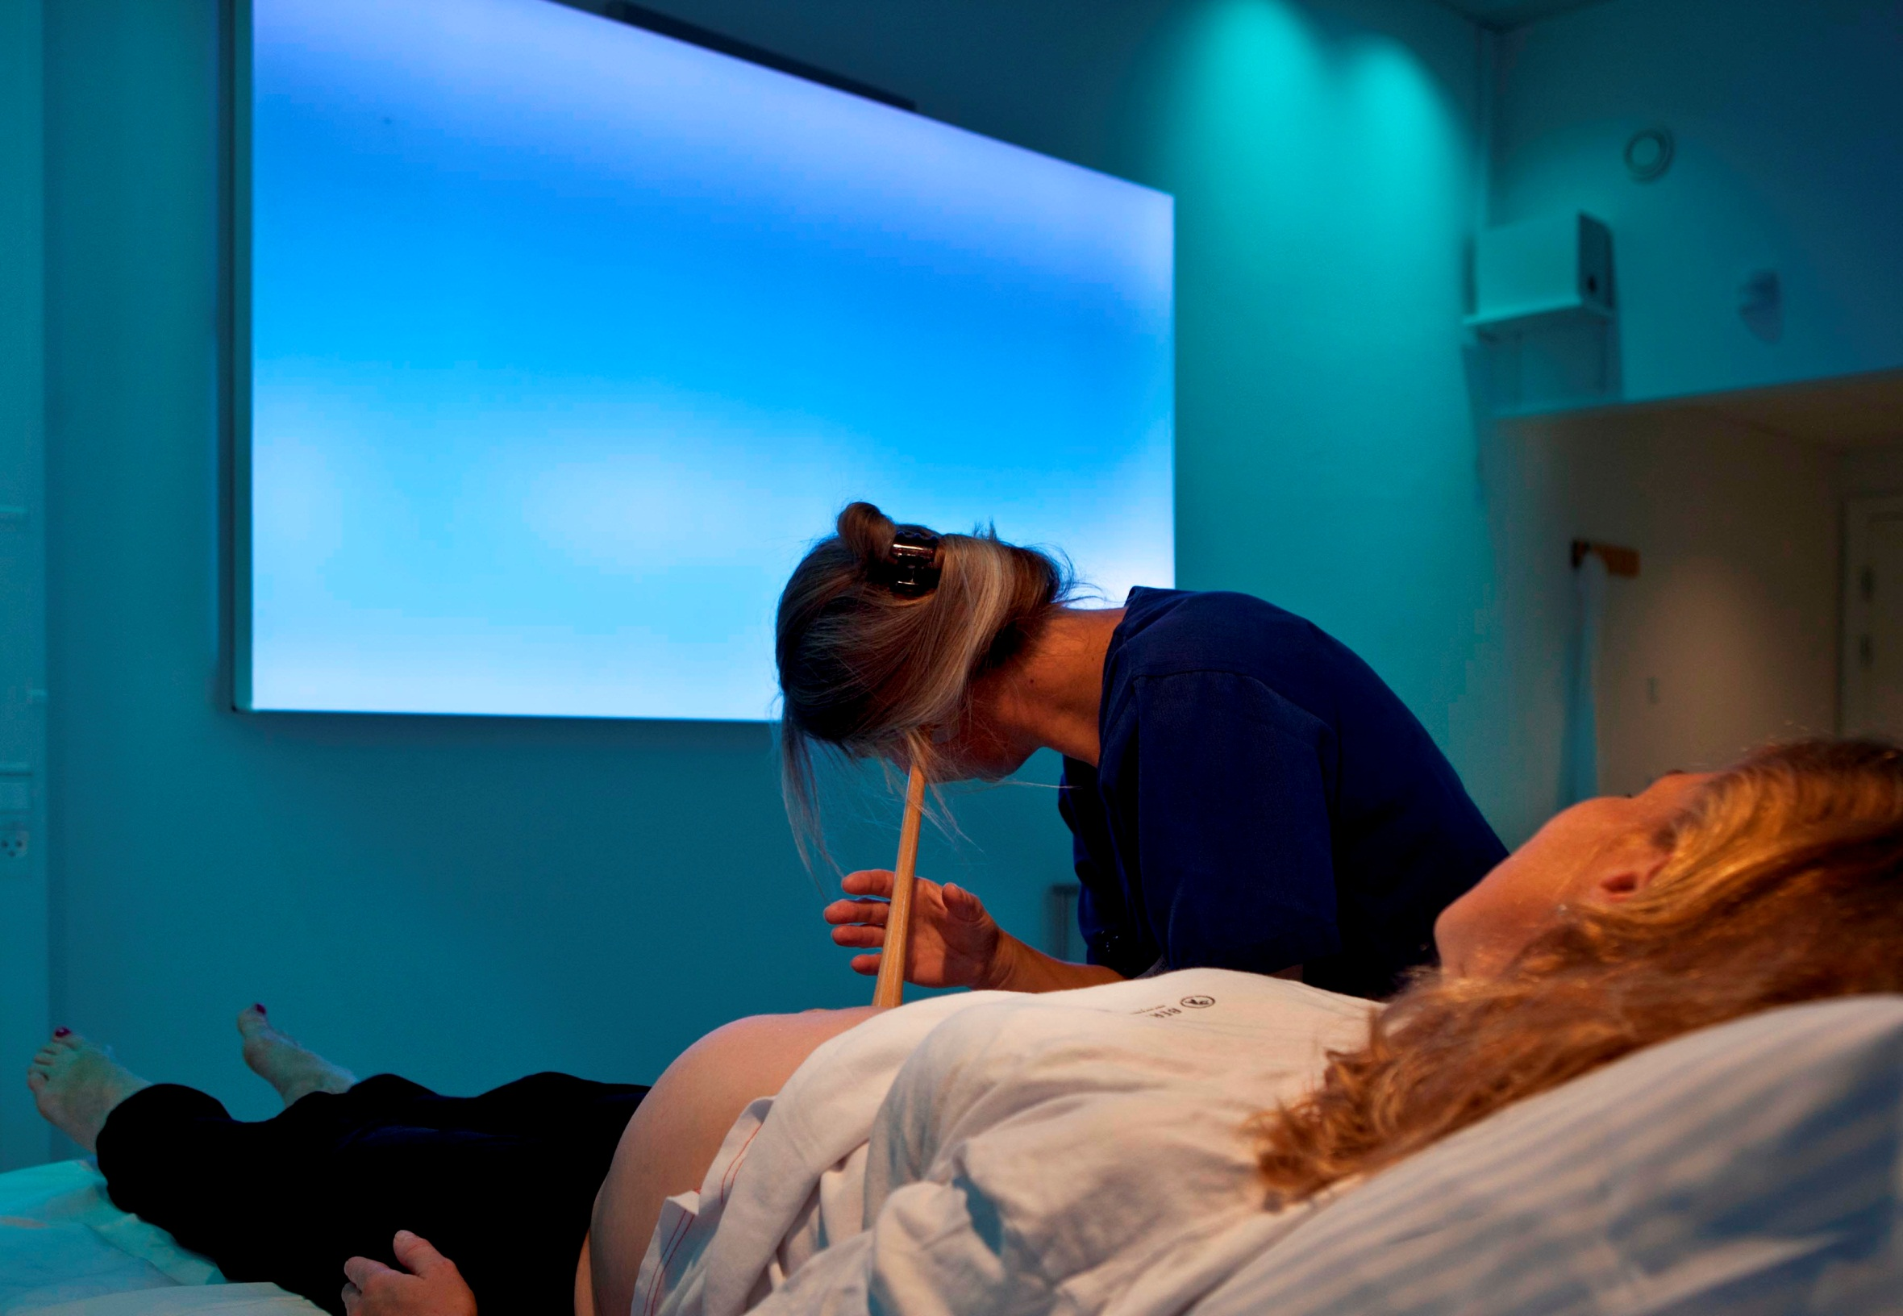
Nordsjællands Hospital, Sensory Birthing Room, Hillerød, Denmark
Notes:
Project: Nordsjællands Hospital, Sensory Birthing Room, Hillerød, Denmark
Product: Philips luminous textile
Content: Bjørn Wennerwald, Wavecare ApS
See: http://www.largeluminoussurfaces.com/content/prdkhillerod-delivery-rooms

Slide 21
Key values

Slide 22
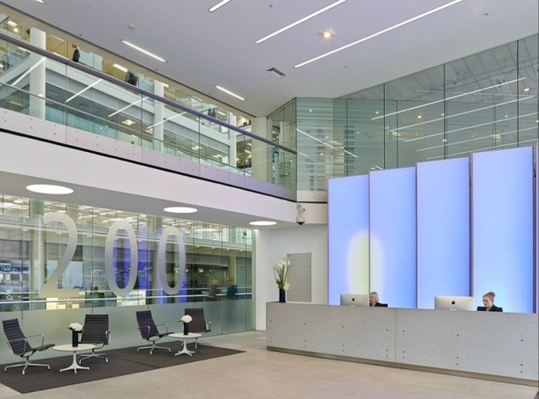
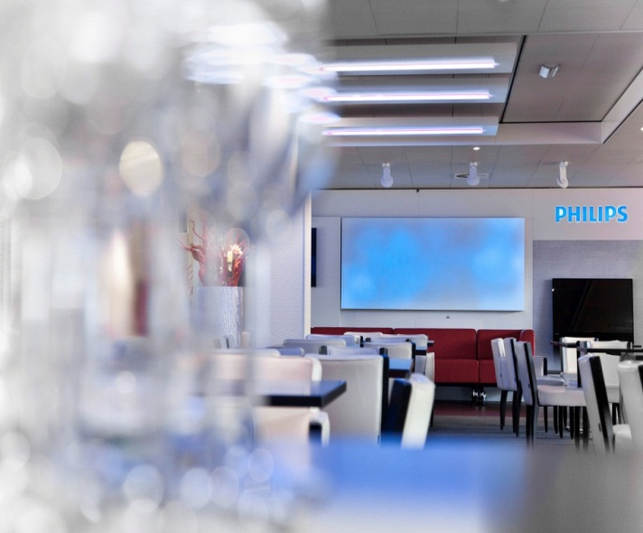
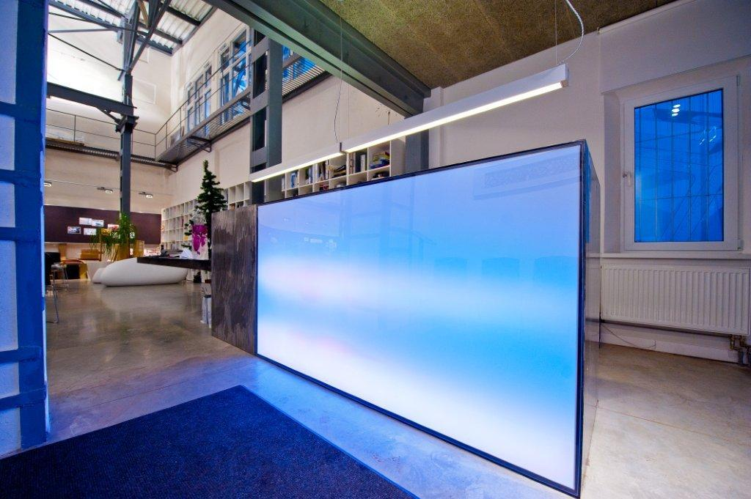
Philips luminous textile with Kvadrat Soft Cells
Key Values
Design freedom
Customized sizes
30+ high quality Kvadrat textiles
Standard and customised dynamic video content
Wall/ceiling/recessed/suspended mounting
Freedom of composition
Easy to install
Integrated solution (only panel and socket needed)
Simple wall/ceiling mounting
with only brackets or magnets
Easy to use
Via mobile device, remote or system integration
Easy creation, editing and uploading of content with content manager software
Acoustic properties
Damp noise and improve acoustic environment
Notes:
Slide intent:
Explanation of the different key values of Philips luminous textile with Kvadrat soft cells.

Slide 23
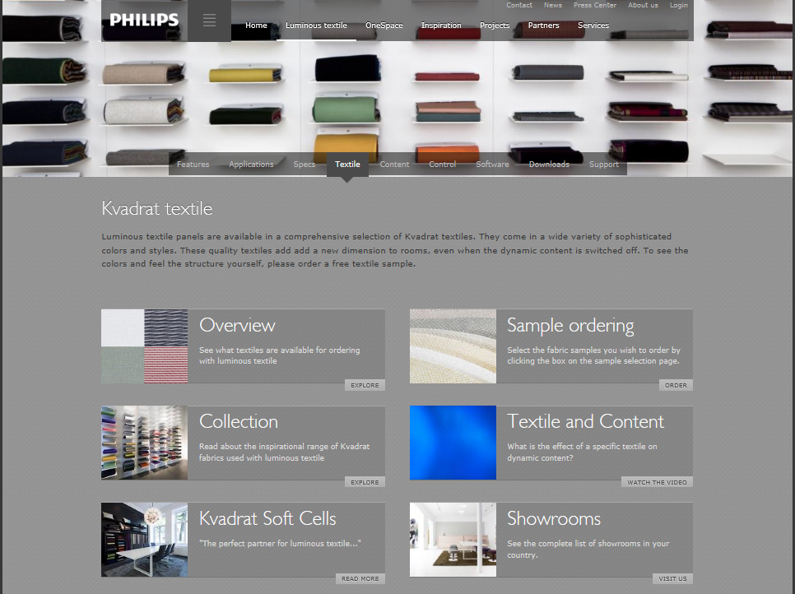
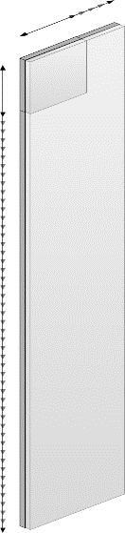
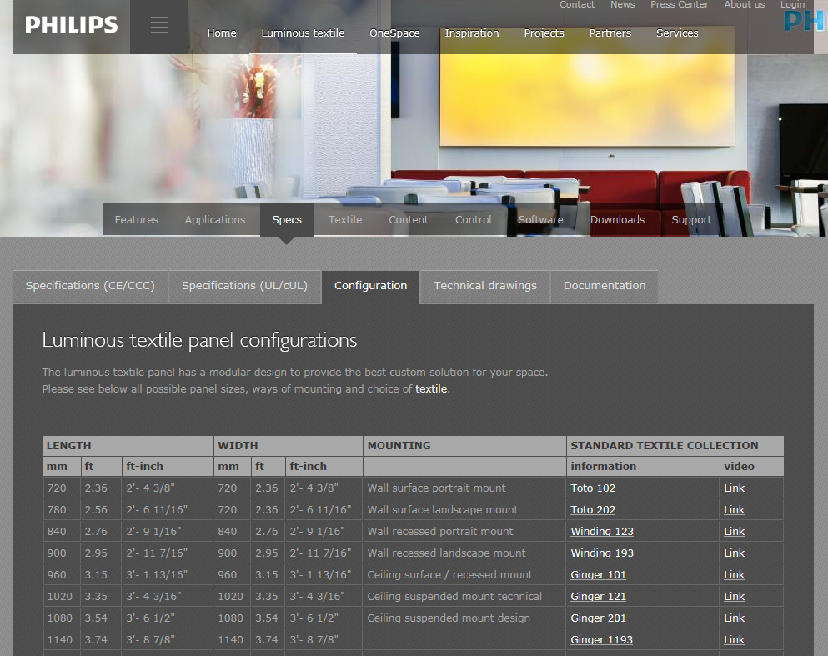
Design freedom
Kvadrat textiles
30+ high quality Kvadrat textiles
Selection of different textures
Up to 8 different colours
Customized sizes
720 – 1200 mm width
Increments of 60 mm
distance between the
RGB LED nodes (pitch)
720 – 6480 mm height
http://www.largeluminoussurfaces.com/luminoustextile
8
Notes:
Slide intent:
Explanation of variety of textiles of our partner Kvadrat
Image
Kvadrat showroom Amsterdam

Slide 24
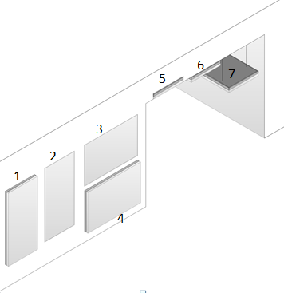
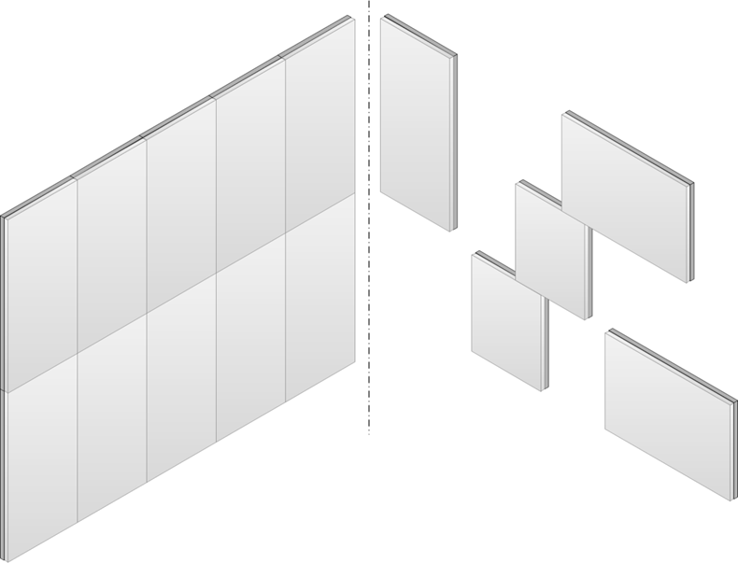
Design freedom
Wall/ceiling/recessed/suspended mounting
Wall surface mounted
Wall recessed mounted, portrait
Wall recessed mounted, landscape
Wall surface mounted, landscape
Ceiling recessed
Ceiling surface mounted
Suspended
Freedom of composition
Multiple lay out possibilities
Full wall or scattered
Combination with Soft Cells
Using streaming any
orientation
8
Notes:
Slide intent:
Show varietyo f mounting possibilities of luminous textile panels to a wall or ceiling.

Slide 25
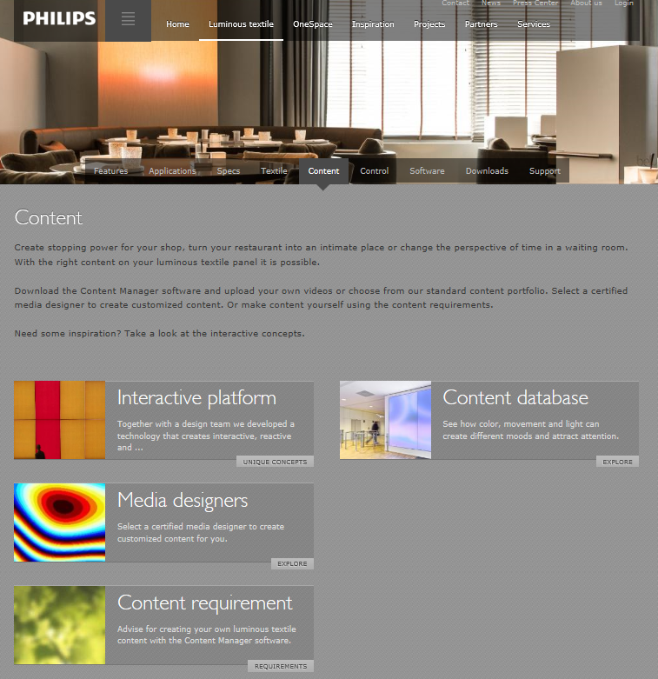
Design freedom
Dynamic video content
Content database of themes
(figurative – abstract – nature)
Based on requirements of
different application
spaces (timing, mood)
Support for media designers
But you also can also create your own content.
http://www.largeluminoussurfaces.com/luminoustextile/content
8
Notes:
Image
http://www.largeluminoussurfaces.com/content/prnlbelugamaastricht

Slide 26
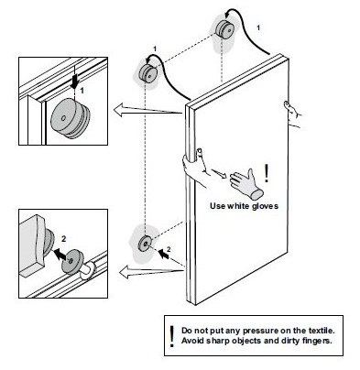
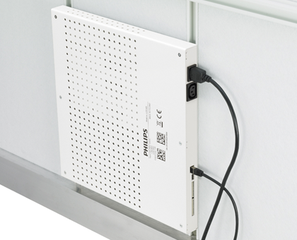
Easy to Install
Integrated solution
Integrated solution (only panel and socket needed)
Simple mounting like a painting on the wall
Easy mounting to ceiling
Using only brackets, magnets and safety wires
8
Notes:
Slide intent:
Explanation of easy installation of luminous textile panels.
Image
Driver box

Slide 27
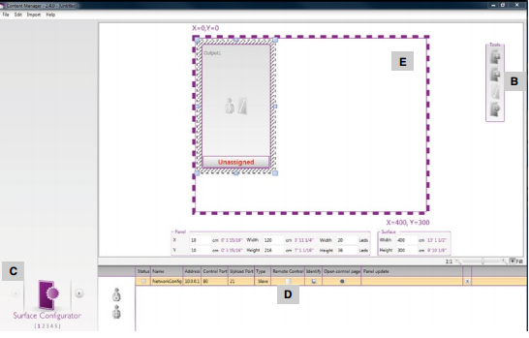
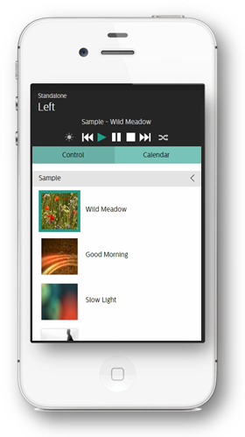
Easy to use
Uploading and Use
content manager software
- creation, editing and uploading content
Uploading consists of 4 steps:
- Identify the panels
- Import, scale and edit content
- Preview the result
- Schedule and upload to the installation
Smart control via:
Mobile device
Remote control
System integration
DiscoverMe LTP app
8

Slide 28

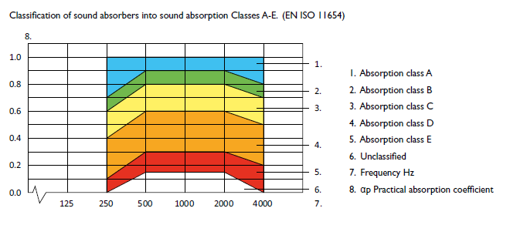
Acoustic properties
Luminous textile | soft sound
EN ISO 11654 sound absorption Class D
Weighted sound absorption coefficient: 0.45 (LM)
Damp noise and improve acoustic
environment
Modular construction
Suitable as building components
Post fitting, to control sound absorption
8
Notes:
Slide intent:
Explanation of acoustic properties.
Image
Soft sound

Slide 29
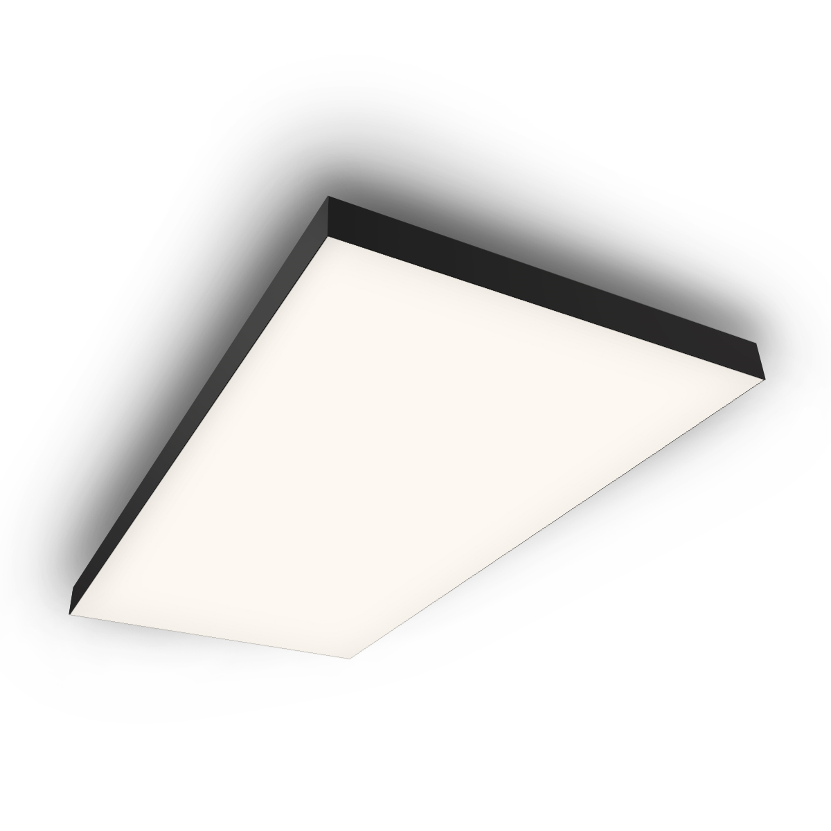


OneSpace luminous ceiling prefab 2018
Positioning statement
Philips OneSpace luminous ceiling prefab is an impressive ultra-thin and compact standard unit with an excellent uniform light distribution, which contributes strongly to the acoustics in the space.
The result is a ceiling unit with an amazing light effect without seeing the light source.

Slide 30
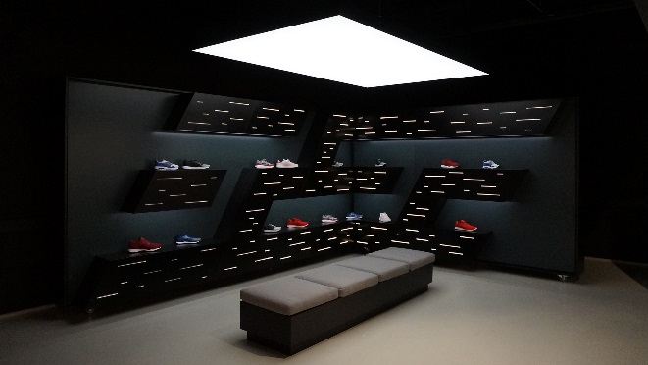
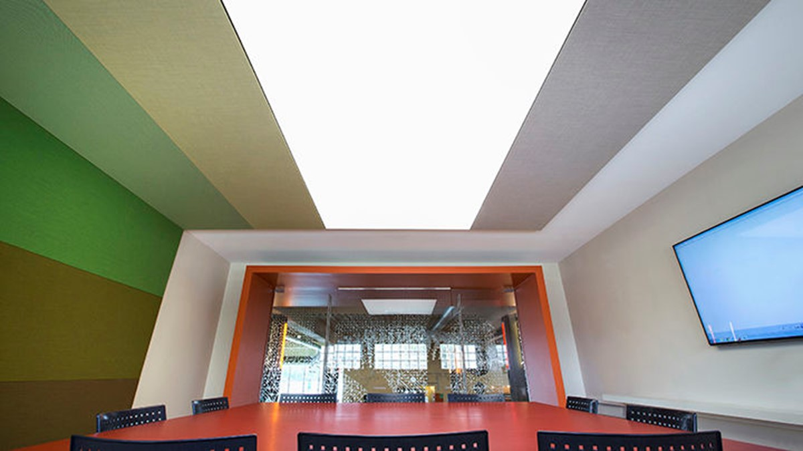
OneSpace prefab 2018
Proposition | Philips OneSpace luminous ceiling prefab
Light effect | Functional white light & increased light output & full dimmable
Type of light | Static white light in 3000 K, 4000 K and tunable white version
Flexible sizes | Modulair design enables multiple sizes
Delivery | Ready to mount & easy mounting interface

Slide 31
Value proposition
OneSpace gives light that recalls the feeling of natural daylight, creating a serene and calm space.
This makes it a great functional light to work and be under and feels as good as it looks.
The thin compact units blend perfectly in a minimalistic design.

Slide 32
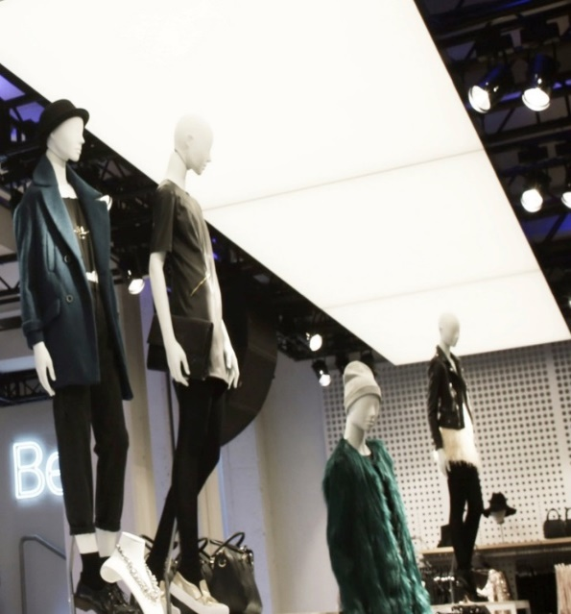
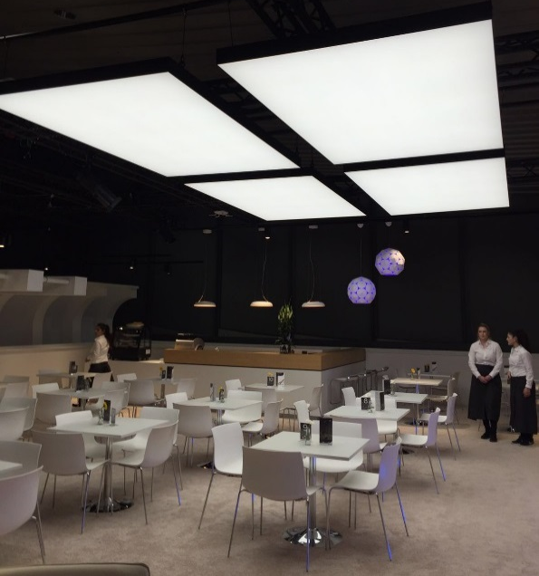
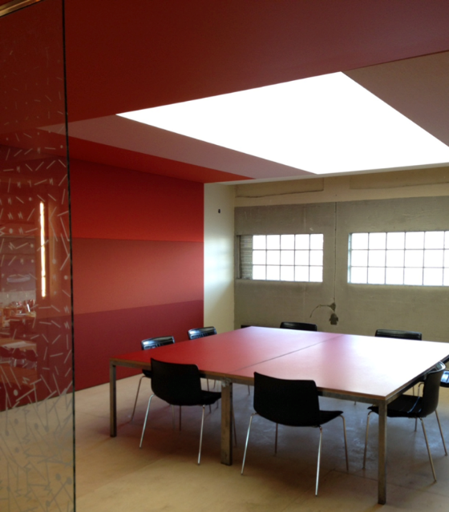
Application areas
Retail Hospitality Office | meeting room
Bershka flagship store Torino, Italy
Snohetta, Oslo, Norway
People feel at ease, inviting atmosphere
Creates a serene outdoor feeling
Enhances room acoustics, improves well-being and meeting quality.
The improved acoustics and homogeneous light will be less tiring keeping people more focused for longer periods
Liberating design possibilities
Easy to install
Enhances room acoustics
Superior homogeneous uniform light; show products in their true light
Increase time spent in the shop (no rush),
people feel at ease
People feel at ease, inviting atmosphere to sit down and talk
Creates a serene outdoor feeling
No glare, no reflections, no shadows
Enhances room acoustics, improves well-being
Exceeds industry safety standards

Slide 33
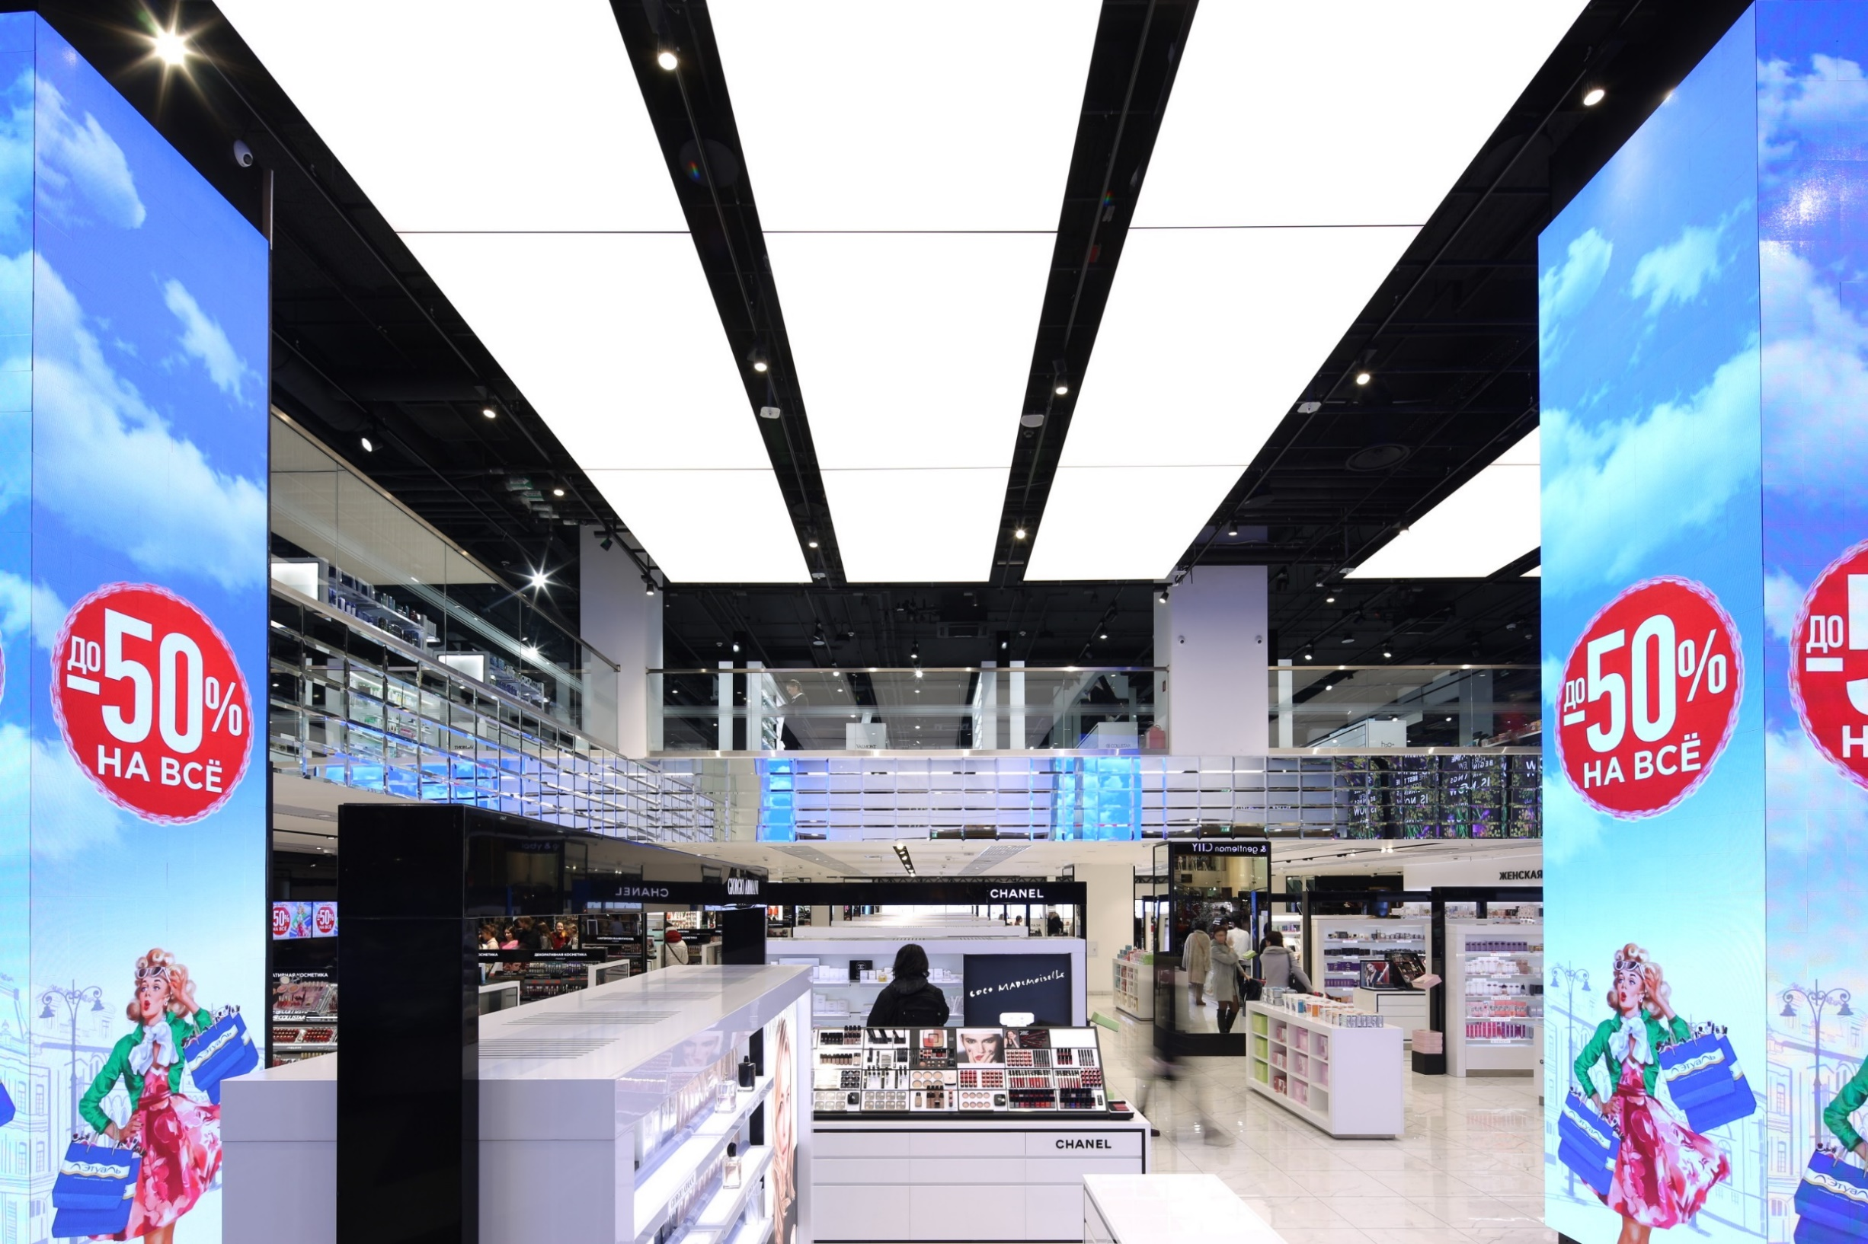
L’Etoille, St Petersburg, Russia

Slide 34
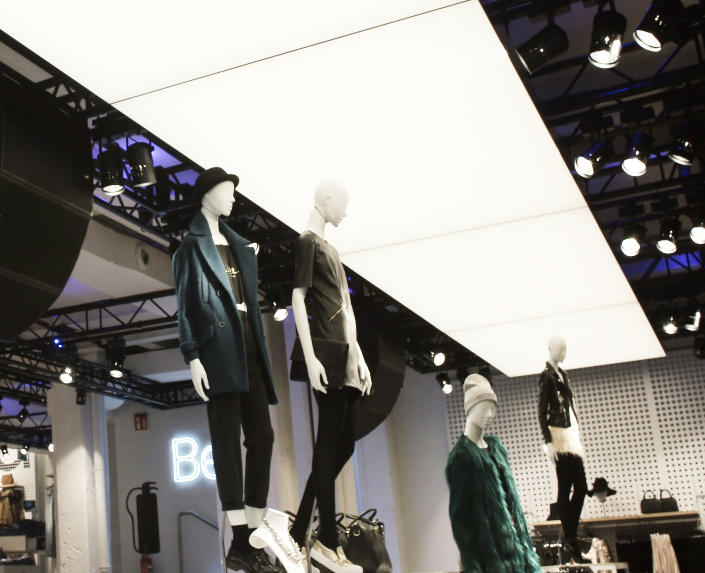
17
Bershka Store, Turin, Italy
Notes:
Image:
OneSpace luminous ceiling prefab @Bershka flagship store, Turin, Italy

Slide 35

17
Kaufland, Gemany / Romania
Notes:
Image:
OneSpace luminous ceiling prefab @Bershka flagship store, Turin, Italy

Slide 36

Banco Popular, Spain, Madrid

Slide 37

14
BMW / Mini Showroom – Tel Aviv - Israel
Notes:
Image
OneSpace luminous ceiling @Lighting Application Center, Lounge, Eindhoven, The Netherlands

Slide 38

14
Kvadrat SHowroom
Notes:
Image
OneSpace luminous ceiling @Lighting Application Center, Lounge, Eindhoven, The Netherlands

Slide 39



Key values
Superior homogeneous light
Hides the source of light completely
Excellent uniform light distribution
Daylight experience: great functional light to work and be under
Max 3200 lm/m² = 300 fc (at fixture level) (for 4000 K version)
Sensory enhancing
Bright uniform glare-free LED light that eliminates shadows
Enhances room acoustics by reducing disturbing sound:
  ASTM C423 99: NRC 0.6
  EN 11654: $αw$ 0.6 / Class C
  Optional: NRC 0.85 / $αw$ 0.8
Simply smarter
Simple to install and easy to replace fabric
Ultra-thin (120 mm / 4.7 in) panel
Integrates perfectly with building management system
Dimmable (DALI or 0-10V controllable)
Supremely safe
High fire-class safety rating EN 13501: Fabric B-s1, d0 /
panel B-s2, d0(EU), UL723 / ASTM E 84 (US)
1
Notes:
(*) 0.75 with only 600 x 600
Explanation of the different key values of Philips OneSpace luminous ceiling.
No need for additional ceiling (suspended / free hanging)
The great advantage of leaving the concrete ceiling clear and open is that it can provide up to 40% energy savings (source: ‘People work light’, 2010) in new buildings by making optimal use of thermal mass properties of the building. The luminous ceiling solves the lighting need as well as acoustics in buildings with concrete core activation.
No need for additional ceiling (recessed / surface mounted)
Due to the way the panel is mounted to the building, no additional ceiling needs to be installed behind the panel. This saves money on the total system.
Superior homogeneous light
OneSpace integrates LED lights with textile to create a white light ceiling surface that hides the source of light completely. It delivers excellent uniform light distribution for an enhanced
daylight experience, which makes it a great functional light to work and be under. The result is a smooth and clutter-free ceiling of beautiful homogeneous light that feels as good as it looks.
Liberating design possibilities
OneSpace opens up new minimalistic lighting design opportunities. For ultimate design flexibility, the ultra-thin (12 cm) panel is available in one size and can be mounted in multiple ways (free-hanging, ceiling-mounted or recessed).
Simply smarter
OneSpace is simple to install and easy to maintain. The ceiling panel is designed to allow easy access to the unsightly building services
behind it. OneSpace also integrates perfectly with your building management system.
Sensory enhancing
OneSpace not only makes spaces look great, it enhances your experience of them. It delivers bright uniform glare-free LED light that
eliminates shadows completely so you can see more clearly and view objects in their true light.
It even enhances room acoustics by reducing disturbing sound reflections.
Supremely safe
OneSpace exceeds industry safety standards for both fire and mounting. The mounting system
also has a safety factor of over five times higher than the weight of the panel.

Slide 40

DALI Tunable White
Control of:
  Color temperature
  Lumen Output
  Control manually (step less)
  Control by BMS to mimic circadian rhythms (daylight rhythm)
  0-10 V control cannot be used with tunable white
2700ºK
6500ºK
0%
100%

Slide 41





Philips OneSpace luminous ceiling prefab - EU
5 standard dimensions EU
  EU
  1200 x 3000 mm Optional sizes in steps of 300 mm
  1200 x 1200 mm Minimum 900 X 900 mm
  1200 x 2400 mm Maximum 1800 X 3000 mm
  1500 x 1500 mm
  1800 x 2700 mm
Standard: color temp 3000/4000 K and Tunable white, CRI85, black/white frame, NRC 0.6
Optional: CRI>90, other frame colors, NRC 0.85
No hoisting but with mounting interface
Polyester fabric
E-box pre-mounted on back of panel (fixed)
Delivered as ready to install panels
Notes:
Slide intent:
Explanation of the different key values of Philips OneSpace luminous ceiling.
No need for additional ceiling (suspended / free hanging)
The great advantage of leaving the concrete ceiling clear and open is that it can provide up to 40% energy savings (source: ‘People work light’, 2010) in new buildings by making optimal use of thermal mass properties of the building. The luminous ceiling solves the lighting need as well as acoustics in buildings with concrete core activation.
No need for additional ceiling (recessed / surface mounted)
Due to the way the panel is mounted to the building, no additional ceiling needs to be installed behind the panel. This saves money on the total system.
Covered back side
The covered back side is insect and dust repellent. This backing discourages insects from landing or climbing in or on the surface.
Customizable edge colors
The possibility to choose the edge color allows the architect to match the panel with the interior into one cohesive design.
Superior homogeneous light
OneSpace integrates LED lights with textile to create a white light ceiling surface that hides the source of light completely. It delivers excellent
uniform light distribution for an enhanced daylight experience, which makes it a great functional light to work and be under. The result
is a smooth and clutter-free ceiling of beautiful homogeneous light that feels as good as it looks.
Liberating design possibilities
OneSpace opens up new minimalistic lighting design opportunities. It is literally a customizable building block for transforming any ceiling into
a seamless cohesive space. For ultimate design flexibility, the ultra-thin (12 cm) panel is available in made-to-measure sizes (up to 10 m x 3 m), and
can be mounted in multiple ways (free-hanging, ceiling-mounted or recessed). There is also the option to choose the panel’s edge color.
Simply smarter
OneSpace is simple to install and easy to maintain. The ceiling panel is designed to allow easy access to the unsightly building services
behind it, and has a covered backing that is both dust and insect repellent. OneSpace also integrates perfectly with your building
management system.
Sensory enhancing
OneSpace not only makes spaces look great, it enhances your experience of them. It delivers bright uniform glare-free LED light that
eliminates shadows completely so you can see more clearly and view objects in their true light.
It even enhances room acoustics by reducing disturbing sound reflections.
Supremely safe
OneSpace exceeds industry safety standards for both fire and mounting. The ceiling panel is composed of incombustible glass fiber and
aluminum, and carries an industry-leading A2 fire-class safety rating. The mounting system also has a safety factor of over five times higher
than the weight of the panel.

